Slide 1
SECURE DATA HIDING IN IMAGES USING STEGANOGRAPHY
CAPSTONE PROJECT
Presented By: Rutika Raju Chavan
Student Name : Rutika Raju Chavan
College Name & Department : Parvatibai Genba Moze College of Engineering Pune, Maharashtra

Slide 2
OUTLINE
Problem Statement
Technology used
Wow factor
End users
Result
Conclusion
Git-hub Link
Future scope

Slide 3
Problem Statement
In the digital age, securing sensitive data has become a critical concern, especially with the increasing instances of cyber-attacks and data breaches. Traditional encryption techniques often expose the presence of the protected data, making it vulnerable to interception by unauthorized parties. Steganography, the art of concealing data within another medium, offers a promising solution by embedding secret information within seemingly innocuous files like images, audio, or video.
* The goal of this project is to design and implement a secure data hiding mechanism in digital images using steganography, which fulfills the following criteria:
Security: Ensure that the hidden data is encrypted and resistant to unauthorized extraction.
Stealth: The hidden data should not noticeably distort the host image, making it undetectable to human perception and steganalysis tools.
Robustness: The steganographic method should be resilient to common image manipulations, such as resizing, compression, or cropping.
Efficiency: The method should not introduce significant computational overhead or excessive storage requirements.

Slide 4
Technology used
* Libraries -
1) cv2 library
2) string
* Platforms -
1)Windows OS
2) Python IDLE
*Hardware /Software Requirements -
1) 4 GB RAM
2) WINDOWS OS

Slide 5
Wow factors
Advanced Encryption Integration – Incorporating state-of-the-art encryption algorithms (like AES or RSA) to protect the hidden data before embedding it in the image adds a layer of security. Even if an attacker detects that data is hidden within the image, they won't be able to decrypt it without the correct keys.
Imperceptible Data Embedding - Achieving high-quality images with minimal distortion, even after embedding large amounts of data, using advanced techniques such as Least Significant Bit (LSB) with Error-Correcting Codes or Discrete Cosine Transform (DCT) to improve invisibility.
User-Friendly Interface for Data Hiding and Extraction - Creating an intuitive graphical user interface (GUI) for users to easily embed or extract hidden data from images without needing technical expertise.
Cross-Platform Compatibility - Developing your steganography tool to work seamlessly across multiple platforms (Windows, Linux, Mac, Android, etc.), so users can securely hide and retrieve data no matter the device or operating system they are using.

Slide 6
End users
The end users for the Secure Data Hiding in Images Using Steganography project would be individuals or organizations who need to securely transmit or store confidential information, with a focus on maintaining privacy and preventing detection by unauthorized parties.
Below are some potential end users for the project:
1. Government Agencies and Military
2. Corporations and Enterprises (especially in sectors like finance, healthcare, and legal)
3. Cyber security Experts and Researchers
4. Cloud Service Providers
5. Educational Institutions and Students (in cyber security and cryptography programs)

Slide 7
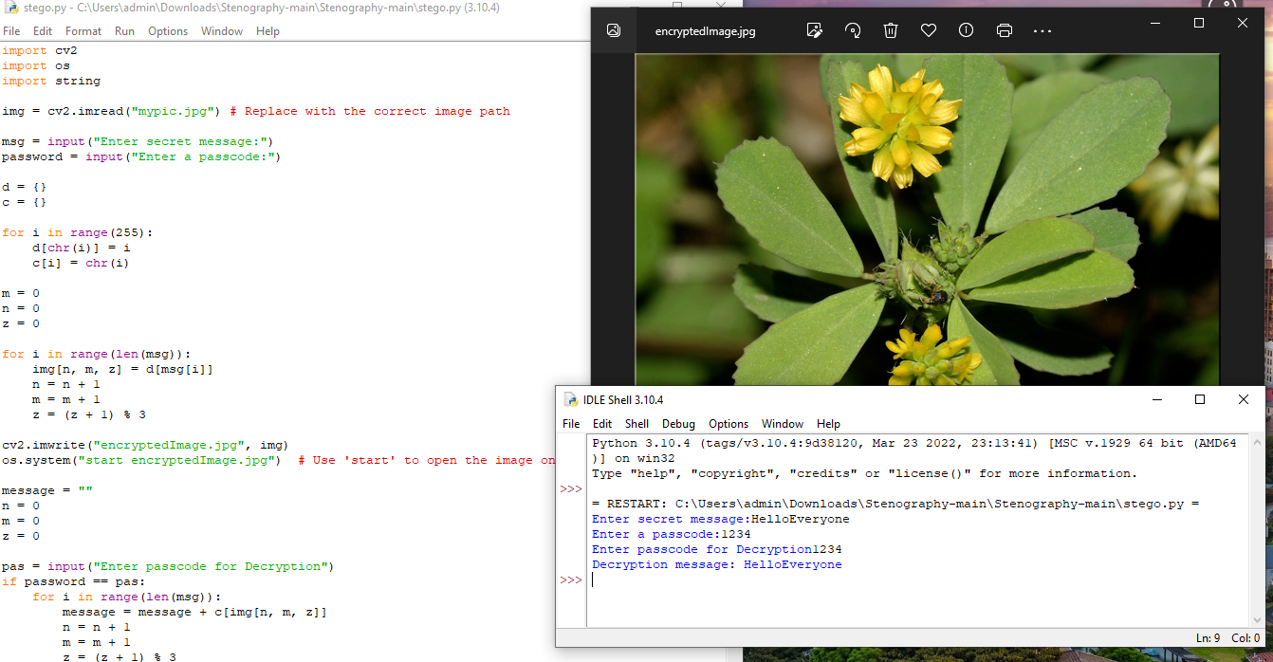
Results

Slide 8
Conclusion
The Secure Data Hiding in Images Using Steganography project presents an innovative solution to the ever-growing need for secure data transmission in a world increasingly vulnerable to cyber threats. By embedding sensitive data within seemingly innocuous digital images, steganography provides a unique way to ensure both the confidentiality and integrity of information while preventing unauthorized access or detection.
This project successfully demonstrates how advanced encryption algorithms, imperceptible data embedding techniques, and robustness against image manipulations can be combined to create a secure and effective method of hiding data within images. It showcases how security can be enhanced through multi-layered encryption, ensuring that even if the hidden data is detected, it remains unreadable without the appropriate decryption keys.

Slide 9
GitHub Link
https://github.com/rutikachavan14/AICTE_Project.git

Slide 10
Future scope(optional)
The Secure Data Hiding in Images Using Steganography project provides a strong foundation for future developments in the fields of cyber security and digital forensics. As technology advances, the potential applications for this project are vast, and there are numerous opportunities to enhance and extend the existing solution. Below are some key areas for the future scope of this project:
1. Integration with Artificial Intelligence (AI) for Dynamic Data Hiding
2. Multimedia Steganography (Beyond Images)
3. Enhanced Security with Quantum Cryptography
4. Cloud-Based Secure Data Hiding
5. Cross-Platform Steganographic Tools for End-to-End Encryption

Slide 11
THANK YOU

